Slide 1
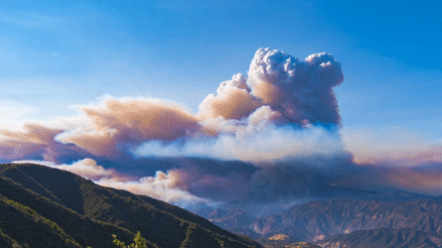
CLOUDSCAPE INSIGHTS
BATCH NO : 12
21071A6918 G SAI RAJ
21071A6932 K NIKHIL
21071A6959 T YOGESH 22075A6904 M AKSHITH
DR.G.NAGARAJU (ASSISTANT PROFESSOR) CSE-AIML&IOT

Slide 2
ABSTRACT:
The rapid growth in satellite imaging technology provides an unprecedented opportunity to analyze and understand cloud formations and behaviors. This study presents a machine learning (ML) model designed to classify and understand clouds using high-resolution satellite images.This model not only enhances weather prediction and climate research but also demonstrates significant potential for operational deployment in meteorological services. The results indicate a high accuracy in cloud type classification, highlighting the efficacy of using ML models for satellite image analysis in atmospheric sciences.

Slide 3

EXISTING SYSTEMS:
Existing systems for cloud classification from satellite images primarily use traditional image processing techniques combined with machine learning models. These systems, developed by meteorological agencies and research institutions, involve steps like image acquisition, preprocessing, and feature extraction before applying machine learning algorithms. These tools are also integrated into broader applications, such as weather forecasting and agricultural practices, to improve accuracy and decision-making in these fields.

Slide 4

PROPOSED SYSTEM:
The proposed system aims to enhance cloud classification and understanding using high-resolution satellite images through advanced machine learning (ML) models. Image preprocessing steps, including calibration, georeferencing, and cloud masking, ensure high-quality inputs. The system employs deep learning architectures, such as convolutional neural networks (CNNs), combined with transfer learning to extract detailed cloud features and improve classification accuracy. Annotated datasets and cross-validation techniques ensure robust model training and validation.. This approach addresses existing limitations by providing accurate, scalable, and real-time cloud analysis, benefiting meteorological and climate research applications.

Slide 5
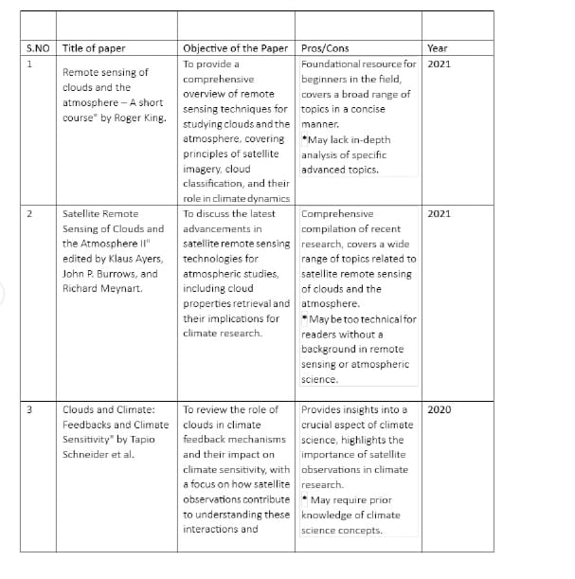
Literature Review:

Slide 6
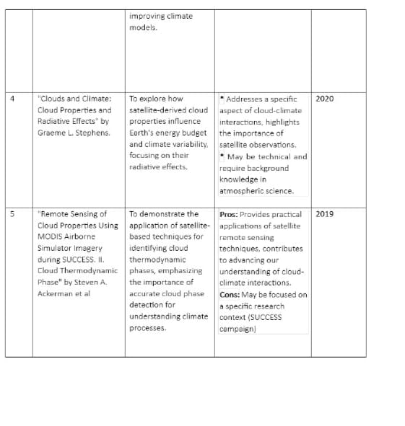

Slide 7
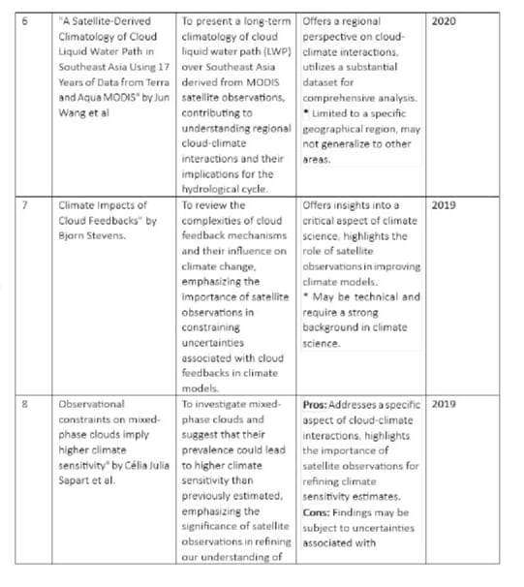

Slide 8
Requirement Verification
Here's a concise component design for building a machine learning model to understand clouds using satellite images:
Data Acquisition and Preprocessing:
Data Retrieval: Fetch satellite images and metadata from sources like NASA or commercial providers.
Preprocessing: Enhance images, correct artifacts, and compute remote sensing indices (e.g., NDVI, NDCI).
Feature Engineering:
Feature Extraction: Extract cloud-relevant features (texture, shape, brightness) from preprocessed images.
Machine Learning Model Development:
Model Selection: Choose and configure ML models (e.g., CNNs, SVMs) suitable for cloud classification or detection.
Training: Train models using labeled datasets, including hyperparameter tuning and validation.

Slide 9
Functional Requirements
Data Pre-Processing
The model takes images from the user and pre-process them into required dimensions.
Classification
The model classifies the given input images from the user into the specified classes.
History
The system maintains the previous 10 search records for easy access and experience.
Responsive Design
The interface should be accessible and usable on various devices, including desktops, tablets, and smartphones.

Slide 10
Non-Functional Requirements
Performance
The system should load map and satellite imagery within 5 seconds.
The system should handle high traffic without significant performance degradation.
Scalability
The system should be able to scale to accommodate a growing number of users and increased data volume.
It should support horizontal and vertical scaling as needed.
Reliability and Availability
The system should be available 99.9% of the time.
The system should have failover mechanisms to ensure continuous availability.
Usability
The interface should be intuitive and easy to use for both novice and experienced users.
The system should provide clear instructions and feedback to the users.

Slide 11
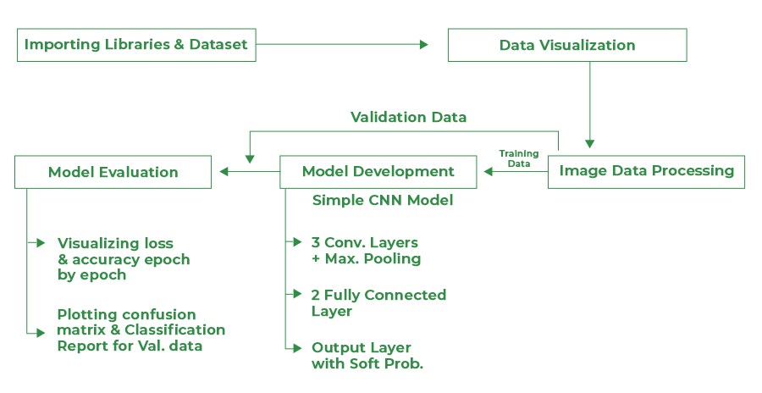

System Architecture :
SYSTEM ARCHITECTURE
Classification:
1.Fish
2.Gravel
3.Sugar
4.Flower
Dataset

Slide 12
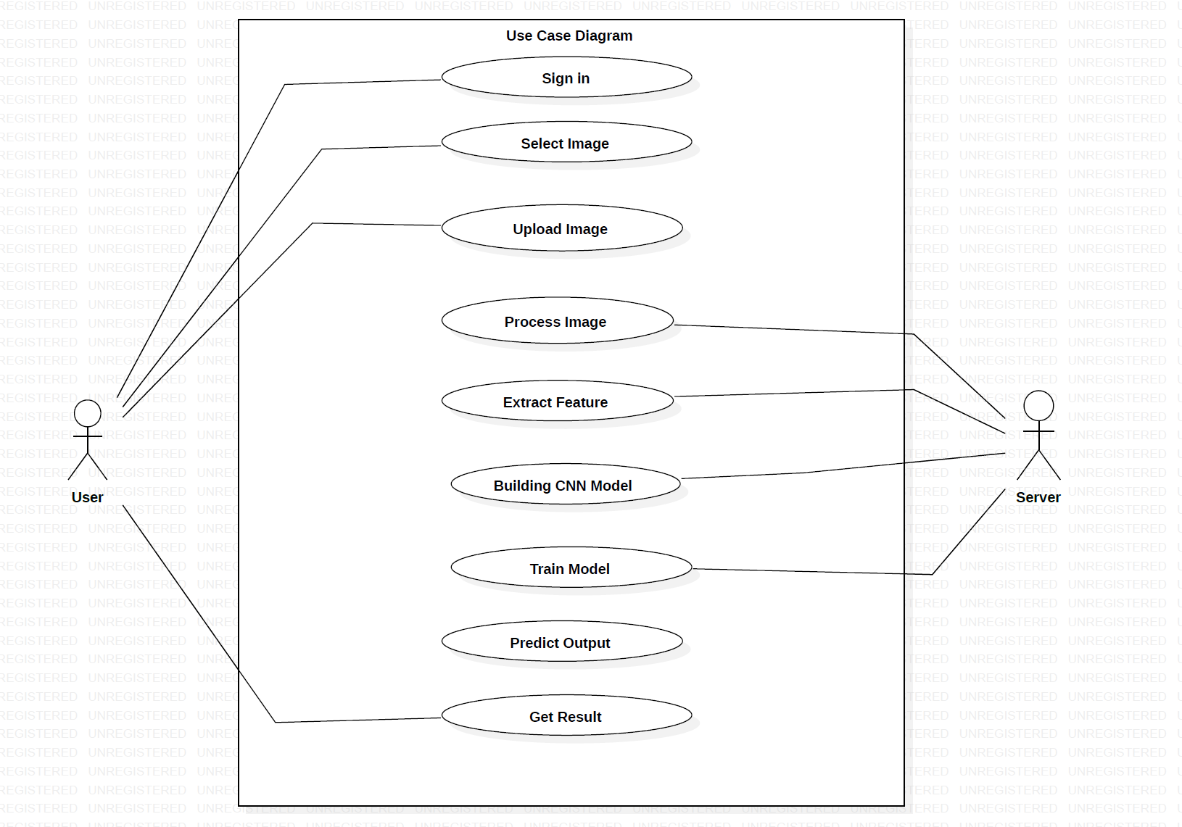
Use-Case Diagram:

Slide 13
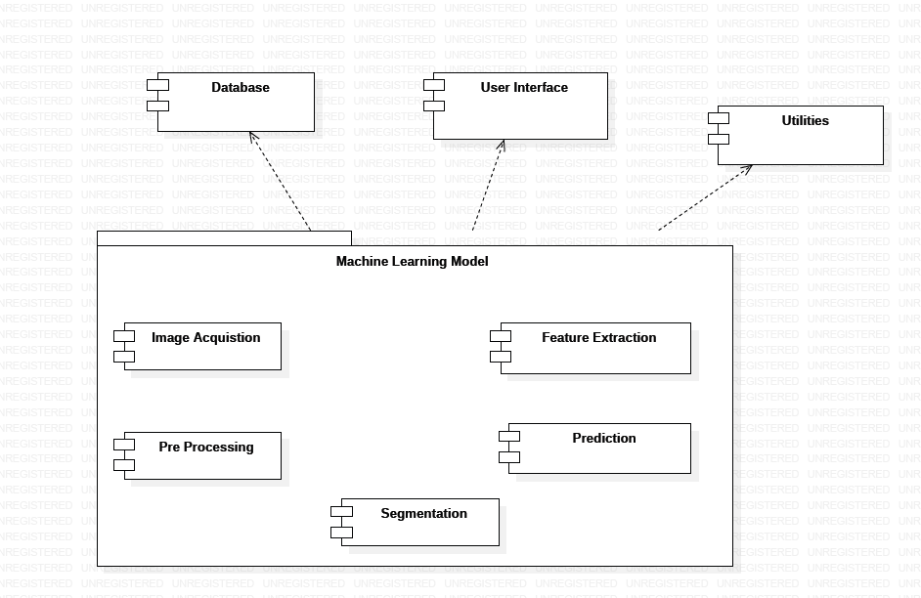

Component Design:

Slide 14
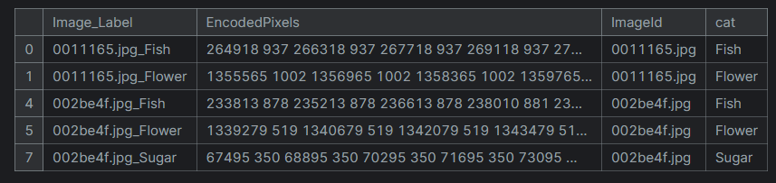
Database Design:
Kaggle Understanding Clouds DataSet
Primary Key: ImageId

Slide 15
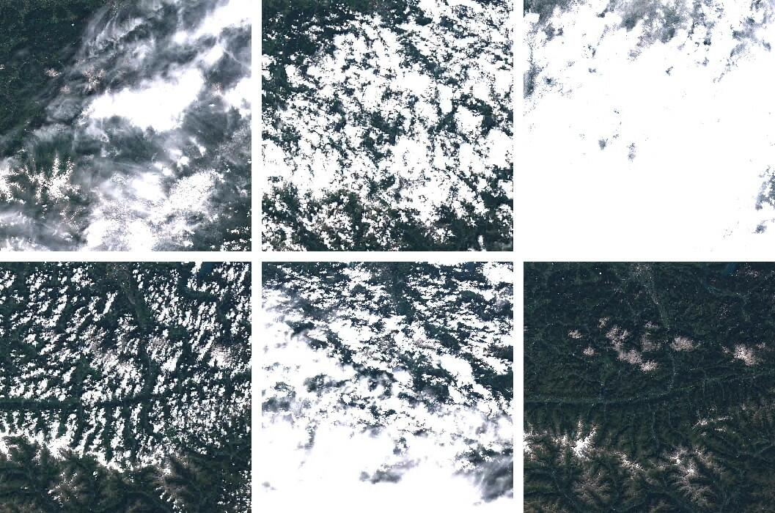
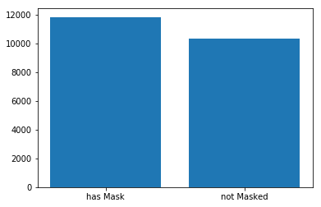
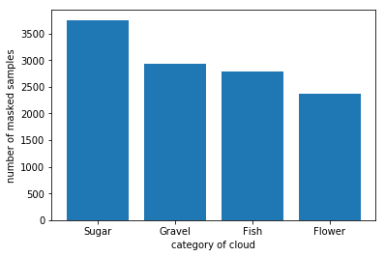
No. of Images: 14792
No. of Classes: 4

Slide 16
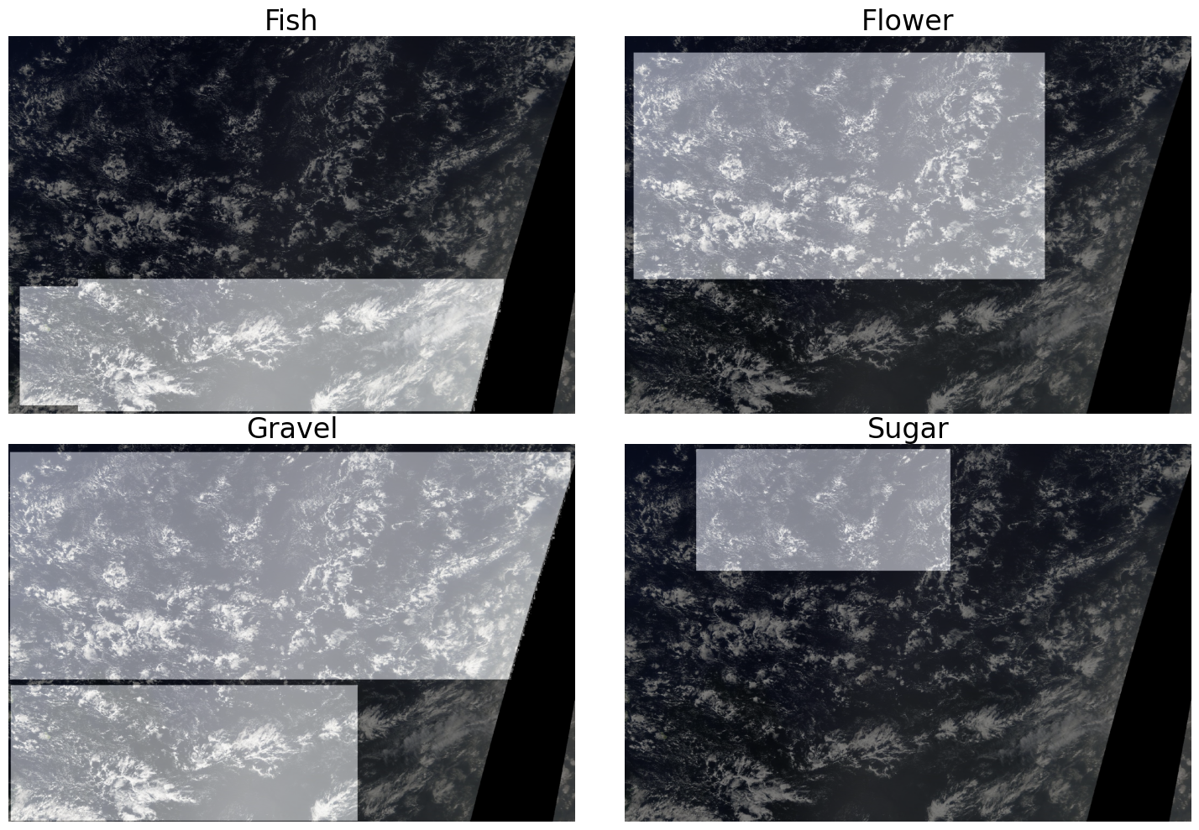
Output:
Number of Unique Clouds: 4
FISH,GRAVEL,SAND,SUGAR

Slide 17
Deployment and Integration:
Deployment: Deploy trained models in scalable environments (e.g., cloud platforms) for real-time or batch processing.
Integration: Interface with APIs for data input/output and interaction with other systems or user interfaces.
Visualization and Reporting:
Visualization: Generate visualizations (e.g., maps, heatmaps) of satellite images and model predictions.
Reporting: Produce reports summarizing cloud analysis results, trends, and anomalies.
User Interaction:
User Interface: Provide interfaces for users to interact with the system, visualize results, and adjust parameters.

Slide 18
Security Considerations
When designing a machine learning model for understanding clouds using satellite images, it's crucial to consider several security aspects to protect data integrity, privacy, and system reliability. Here are key security considerations in a concise format:
Data Encryption: Encrypt satellite images and sensitive data both at rest and in transit to prevent unauthorized access.
Access Control: Implement strict access control measures to ensure only authorized personnel or systems can access sensitive data and ML model components.
Secure Deployment: Deploy the ML model in secure environments (e.g., cloud platforms with built-in security features) and apply security patches regularly.

Slide 19
Performance Considerations
When optimizing performance for a machine learning model designed to understand clouds using satellite images, several key considerations can enhance efficiency and scalability. Here are essential performance considerations in a concise format:
Data Processing Efficiency:
Preprocessing: Optimize image preprocessing steps (e.g., noise reduction, enhancement, feature extraction) to minimize computational overhead and prepare data efficiently for model input.
Model Selection and Architecture:
Algorithm Choice: Select ML algorithms (e.g., CNNs, SVMs) and architectures that balance accuracy with computational efficiency for cloud classification or detection tasks.
Model Complexity: Simplify model architectures where possible without sacrificing performance to reduce inference time and resource consumption.

Slide 20
Training Optimization:
Batch Processing: Use batch processing techniques during model training to efficiently handle large datasets and optimize GPU utilization.
Deployment Scalability:
Cloud Infrastructure: Deploy models on scalable cloud platforms (e.g., AWS, GCP, Azure) to dynamically adjust computing resources based on workload demands.
Inference Speed and Latency:
Model Optimization: Employ techniques like model quantization and pruning to reduce model size and improve inference speed without compromising accuracy.
Caching and Pre-computation: Cache intermediate results and pre-compute frequent computations to minimize latency during real-time inference.

Slide 21
Integration Points
Understanding clouds using satellite images typically involves applying machine learning models to analyze various features and patterns in the images. Integration points for such an ML model could include:
Data Acquisition and Preprocessing:
Satellite Image Retrieval: Integration with satellite data providers or APIs (e.g., NASA Earthdata API, European Space Agency's Copernicus API) to fetch satellite images.
Data Preprocessing: Processing raw satellite images to remove noise, correct for sensor artifacts, and possibly enhance features relevant to cloud analysis.
Feature Extraction:
Image Processing Libraries: Integration with libraries like OpenCV or specialized libraries for satellite image analysis (e.g., GDAL) to extract features such as cloud texture, brightness, shape, and movement.
Remote Sensing Indices: Calculation of indices like Normalized Difference Cloud Index (NDCI) or Normalized Difference Vegetation Index (NDVI) that can help identify cloud-covered areas.

Slide 22
Machine Learning Models:
Model Training: Developing and training machine learning models (e.g., convolutional neural networks, recurrent neural networks) on labeled satellite image data to classify clouds, predict cloud types, or estimate cloud properties (e.g., altitude, water content).
Integration with Cloud Computing Platforms:
Scalability: Leveraging cloud computing platforms (e.g., AWS, Google Cloud Platform, Microsoft Azure) for processing large volumes of satellite data efficiently.
Storage and Retrieval: Storing processed data and models on cloud storage solutions for easy access and scalability.
Visualization and Interpretation:
Visualization Tools: Integrating with tools like matplotlib, seaborn, or GIS software (e.g., ArcGIS, QGIS) for visualizing satellite images and model predictions.

Slide 23
Technology Stack
The list of technologies, frameworks, and tools that could be chosen for development:
Here's a concise technology stack for building a machine learning model to understand clouds using satellite images:
Data Acquisition and Storage:
APIs from NASA WorldView, Kaggle Understanding clouds dataset
Cloud storage (AWS S3, Google Cloud Storage)
Data Preprocessing:
OpenCV, encode utilities for image processing
Dice coefficient for the model evaluation
Machine Learning Framework:
TensorFlow Keras Unet for building and training model
Cloud Computing Platform:
Google Cloud Platform
Visualization:
Matplotlib

Slide 24
Thank You

